Slide 1
Diet Manager with Pet Growth System
2020025079 최영훈 - Management, Coding
2020039086 최민기 - DB, Coding
2022041081 홍준석 - Coding, Testing
2022041056 윤정아 - UI/UX, Designer
Team OSF(Team 2)

Slide 2
Table of Contents
Project Layout
Ideas and Goals
Changes in Early Development
Mid-Final Development
Difficulties during development and Fixes
Preview Video
Future Plans, Q&A

Slide 3
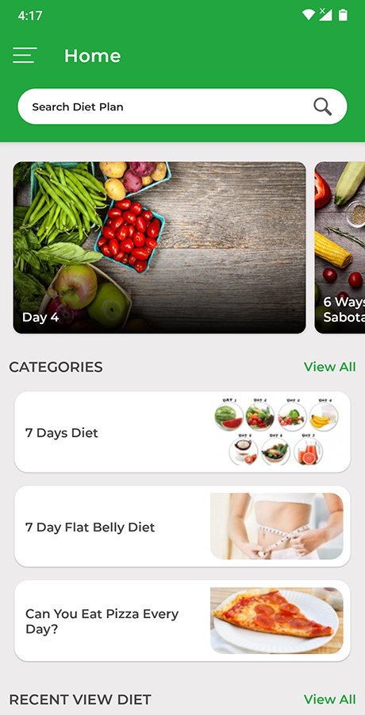
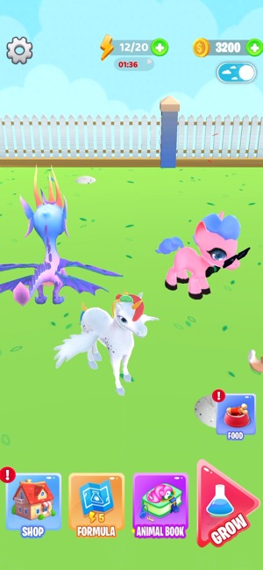
Project Layout
What is the issue on the original ‘Diet Management Apps’?
-> We’ve decided to focus on what we usually played - Games
Games on Idle-RPG style, especially watching pets grow

Slide 4
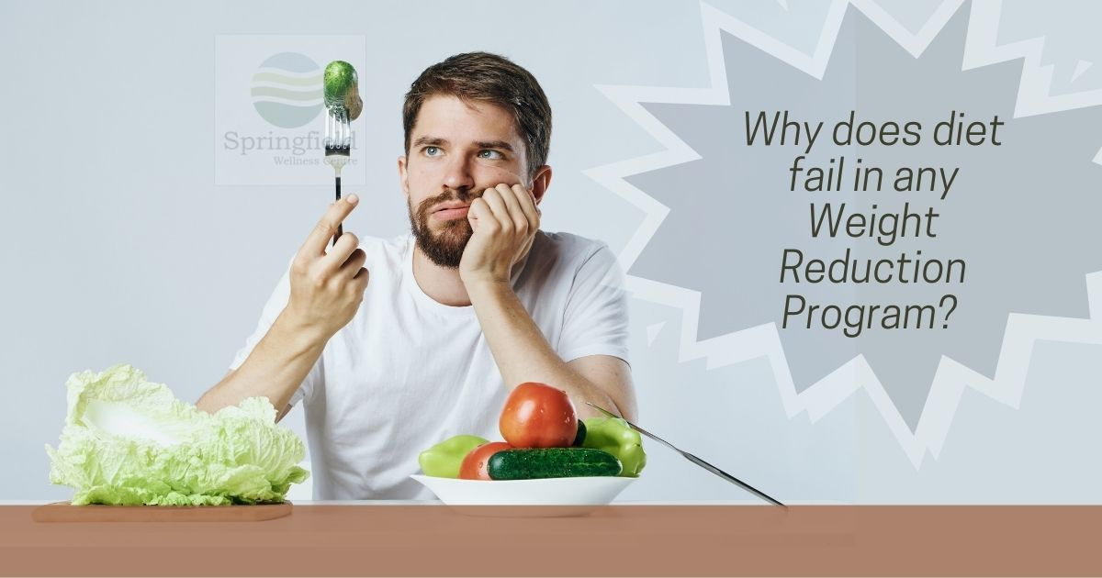
Project Layout
Multiple cases of users quitting mid while the progress, due to low motivation
-> Our app will provide better motivation and goals using showcases of our pet’s status and changes, with goals and missions

Slide 5
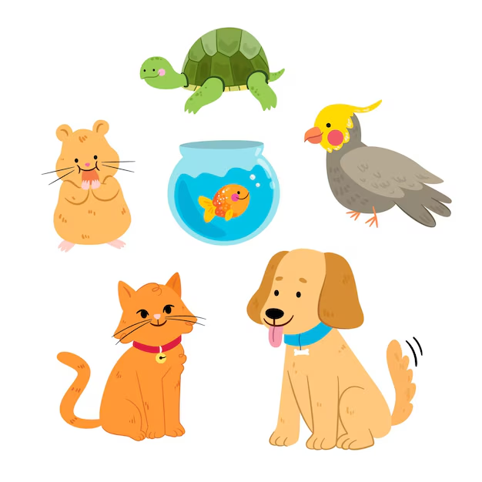
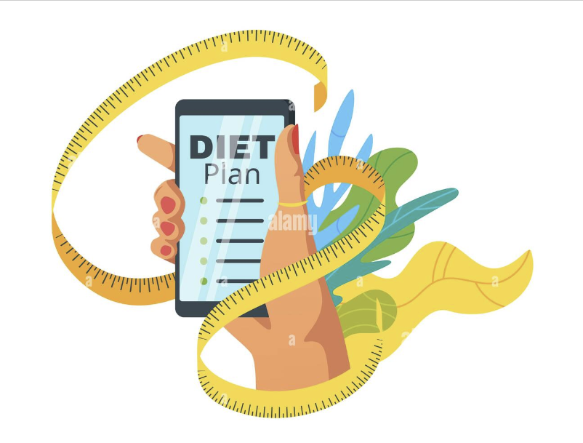
Ideas and Goals
Main goal - Diet Management App ‘but’ combined with a pet growth system

Slide 6
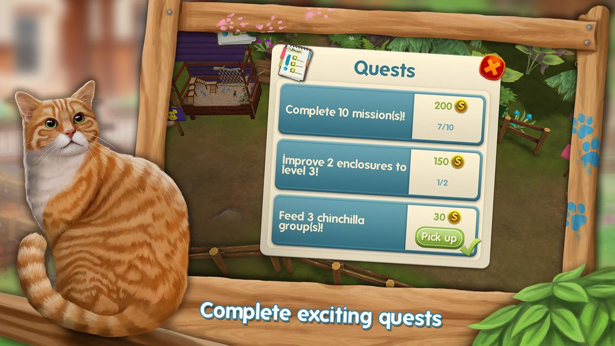
Ideas and Goals
Using an interface style that looks like somewhat from a game, we provided a friendly interface to anyone using this app
get additional in-app currencies to decorate our pet using in-app missions

Slide 7
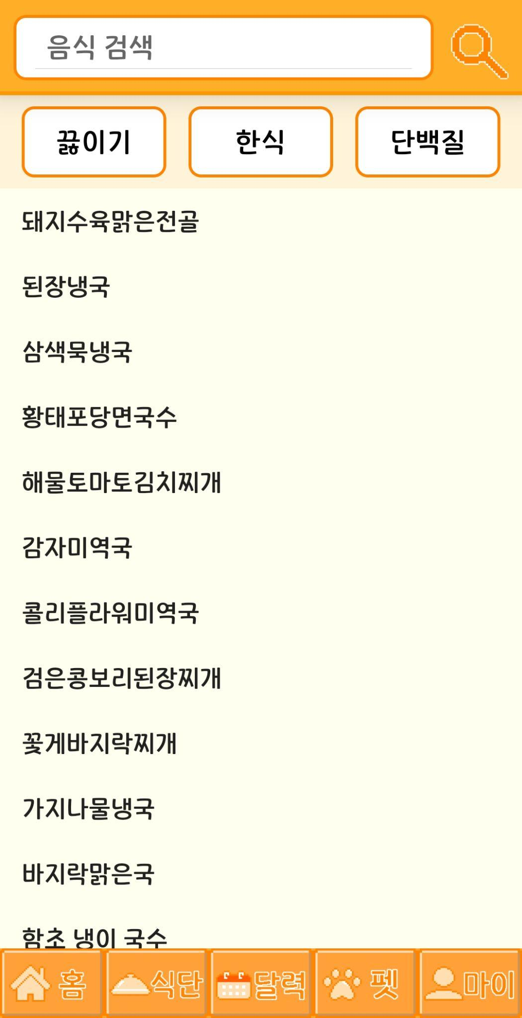
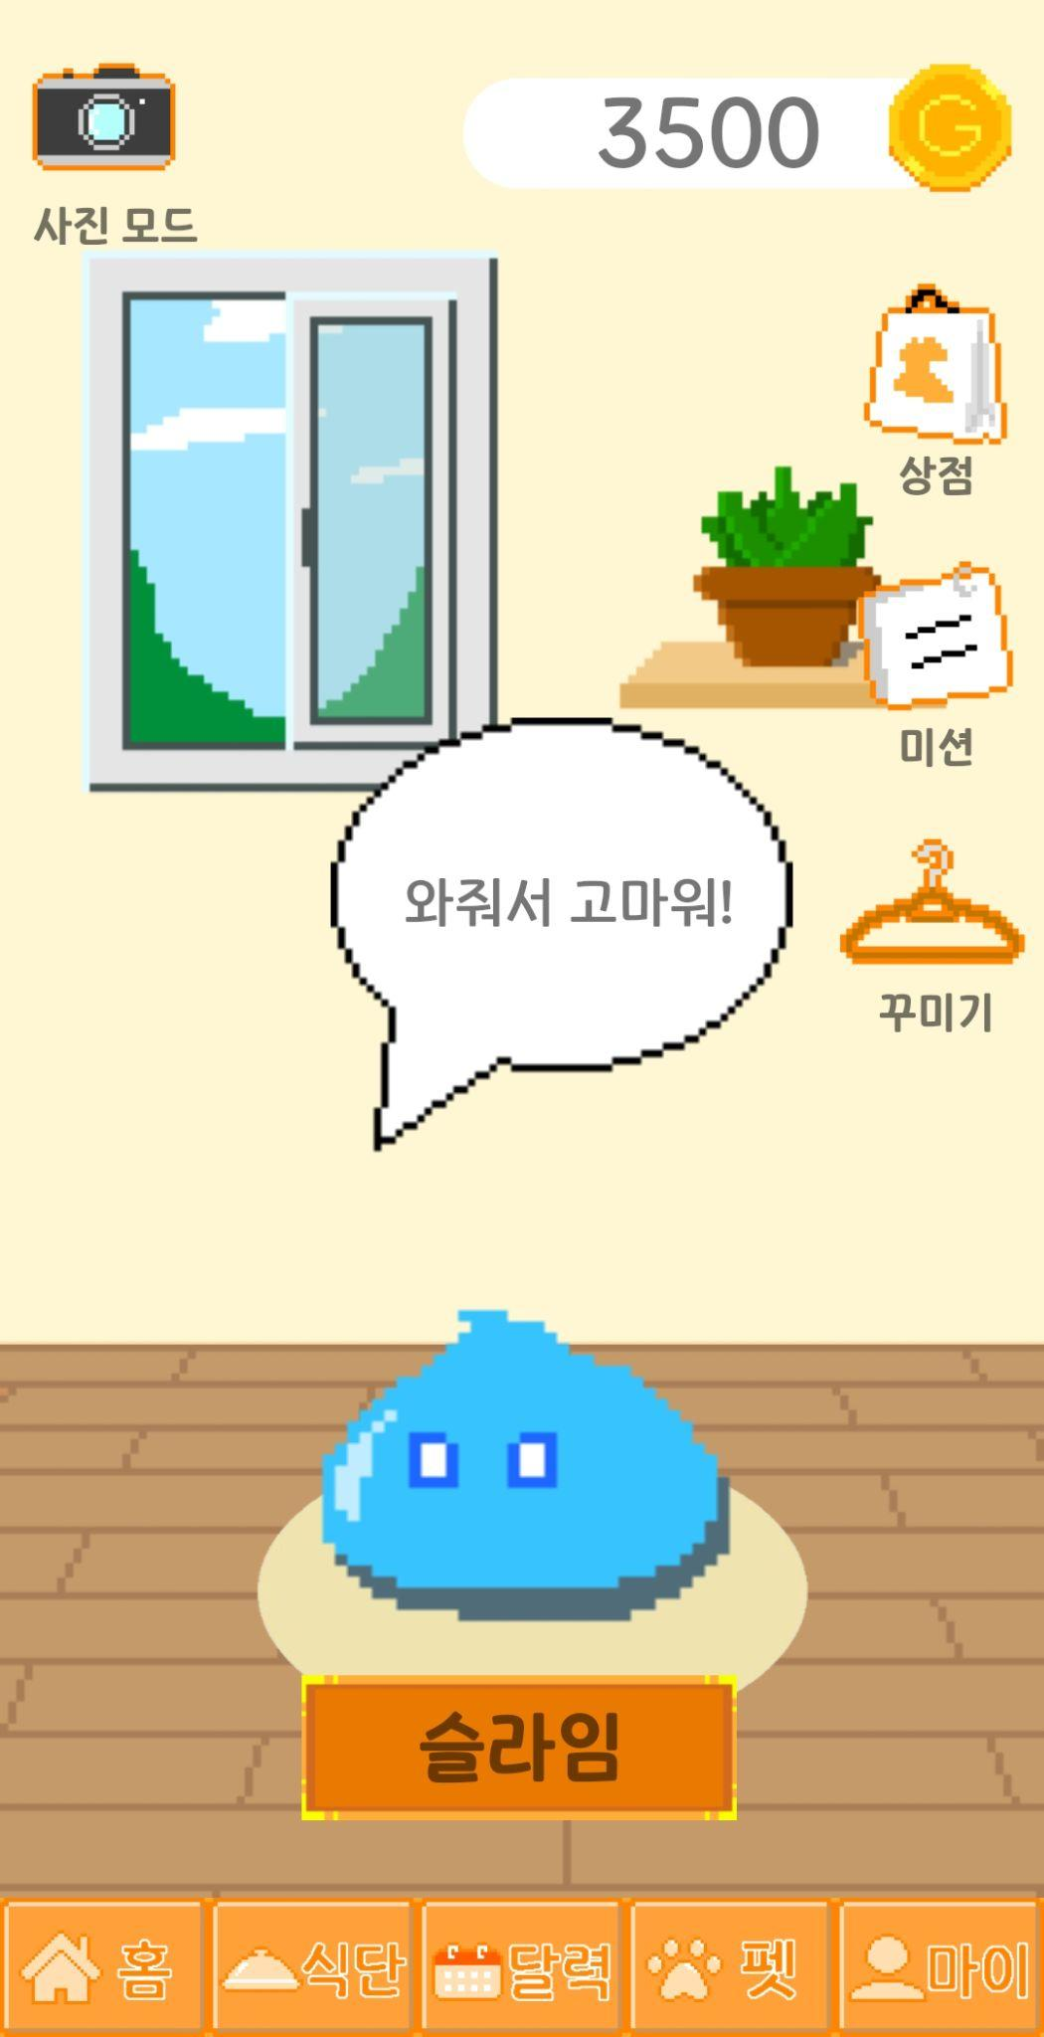
Ideas and Goals
Specific Goals
Motivation related - Pet(Status checks, Decorate the pet using missions and in-app shop)
User’s desired diet - Giving a choice from our database which is filtered with the wanted categories, with the search function to find out which is needed

Slide 8
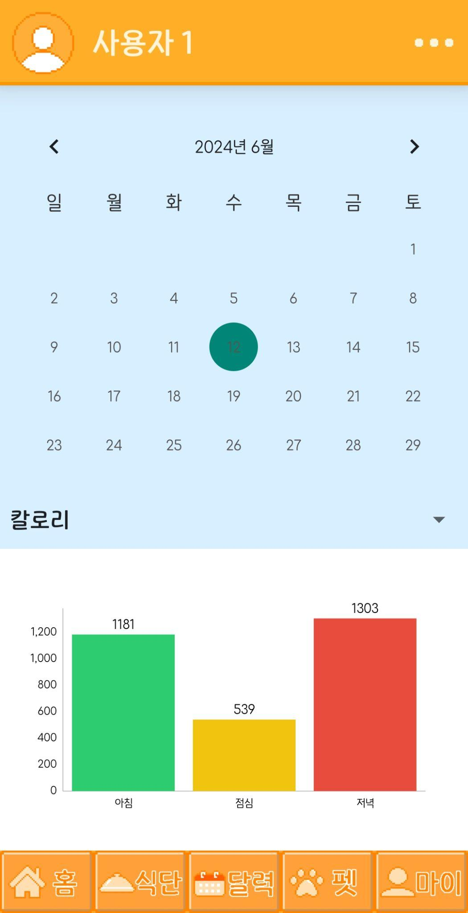
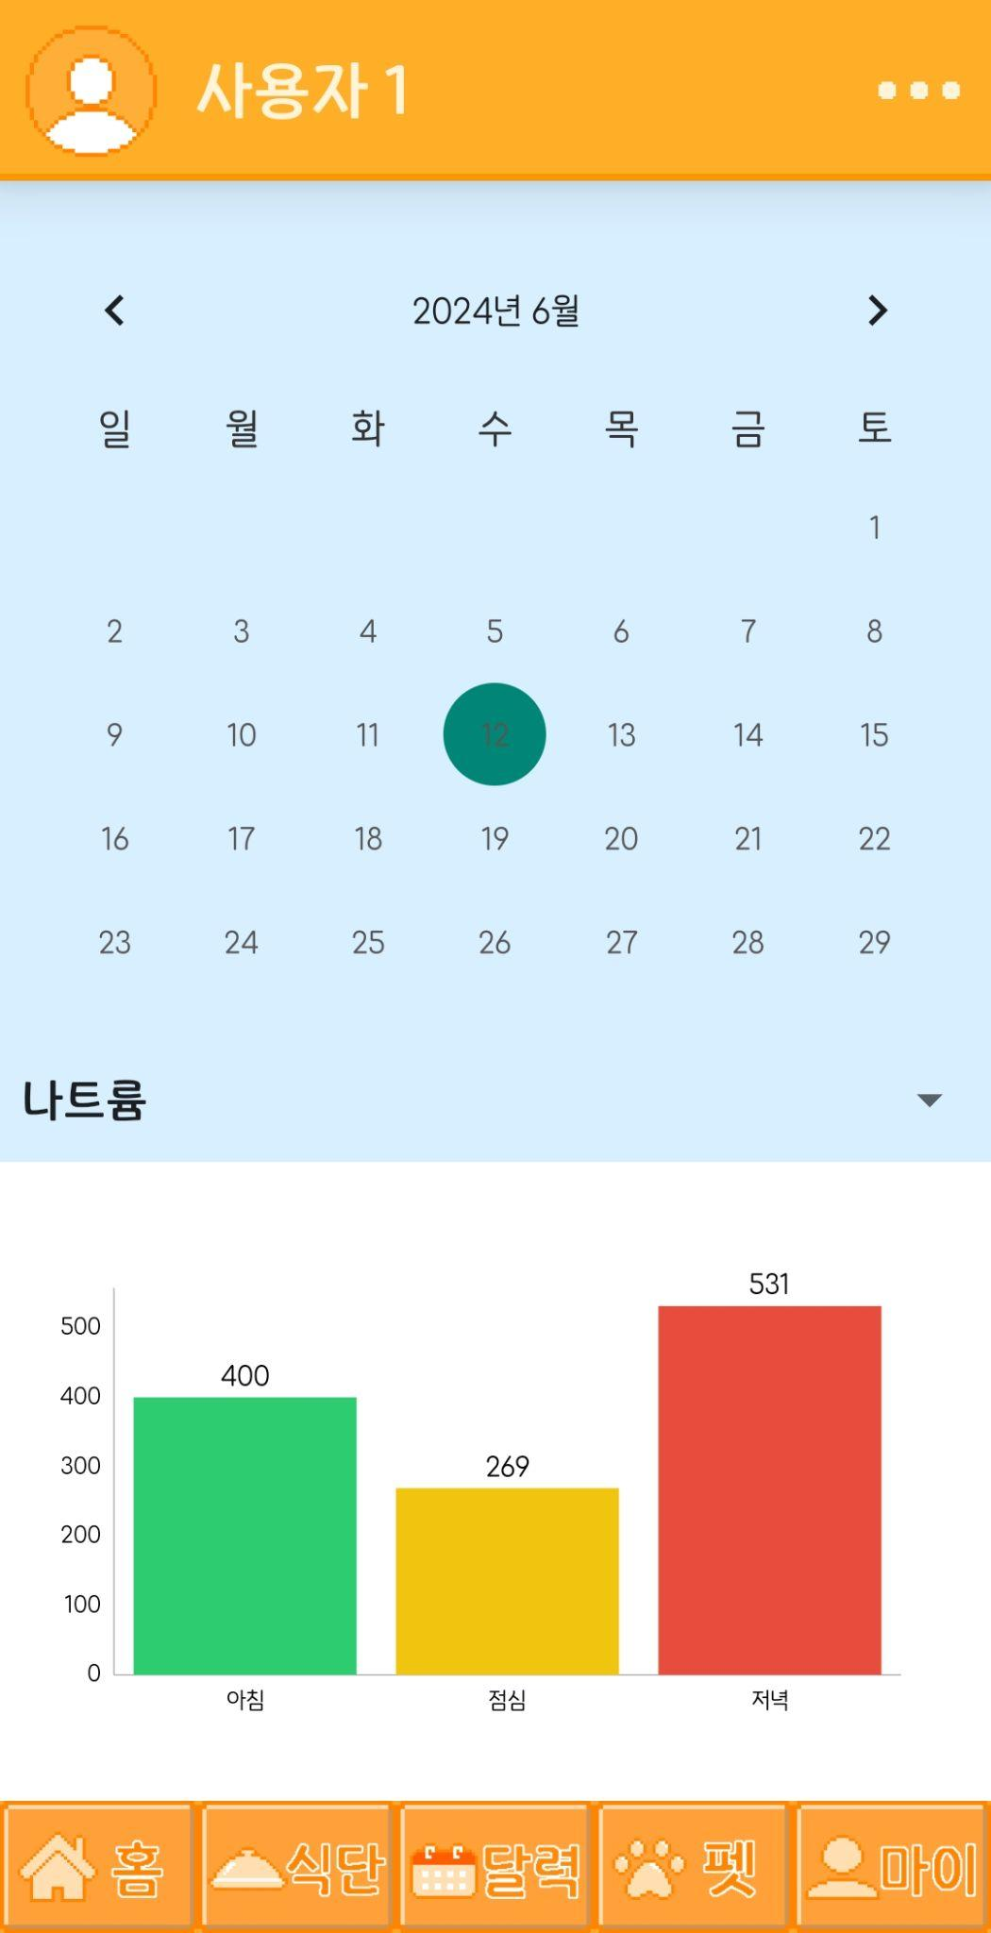
Ideas and Goals
This and by analysis, we can determine what type of food + how much nutrients were consumed
This can also be viewed easier using our in-app Calendar tab

Slide 9
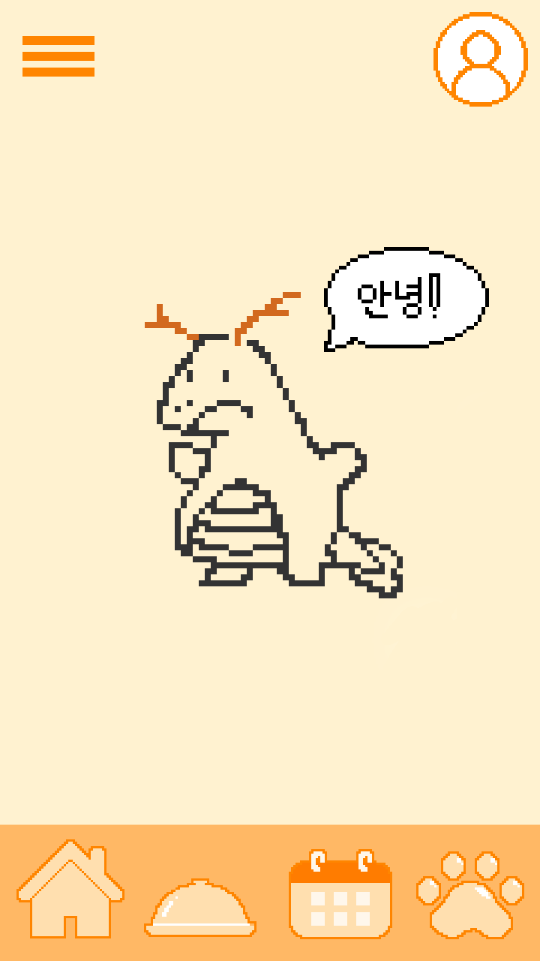
Changes in early development
At first designs, the icons and character, button designs were acceptable - but when put together, a lot felt was missing, which was different from our first designs

Slide 10





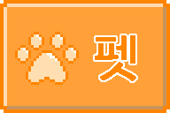
Changes in early development
-> We decided to draw the buttons using a pixelated theme + edit the layout to fix the incomplete design and separate each elements using more decisive lines

Slide 11
Changes in early development
-> By simplifying the character(For example, the slime on the screen) we tried to make it easier for the after designs like wearings, and tools that the pet can use

Slide 12
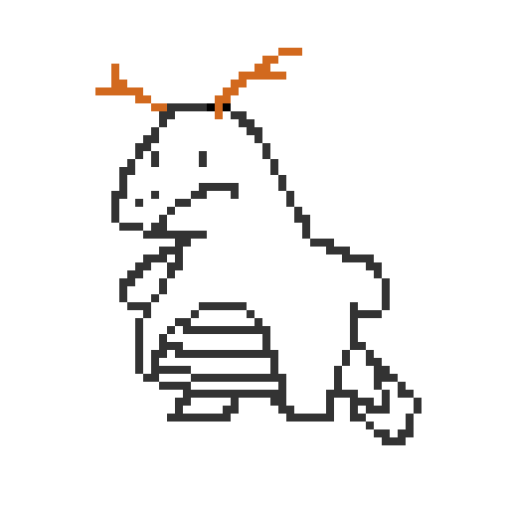
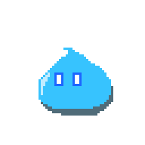

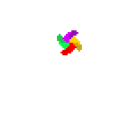

Mid-Final Production
Change in our main character(mascot) -> We used a slime to add better support in designs and future item development + fixes

Slide 13
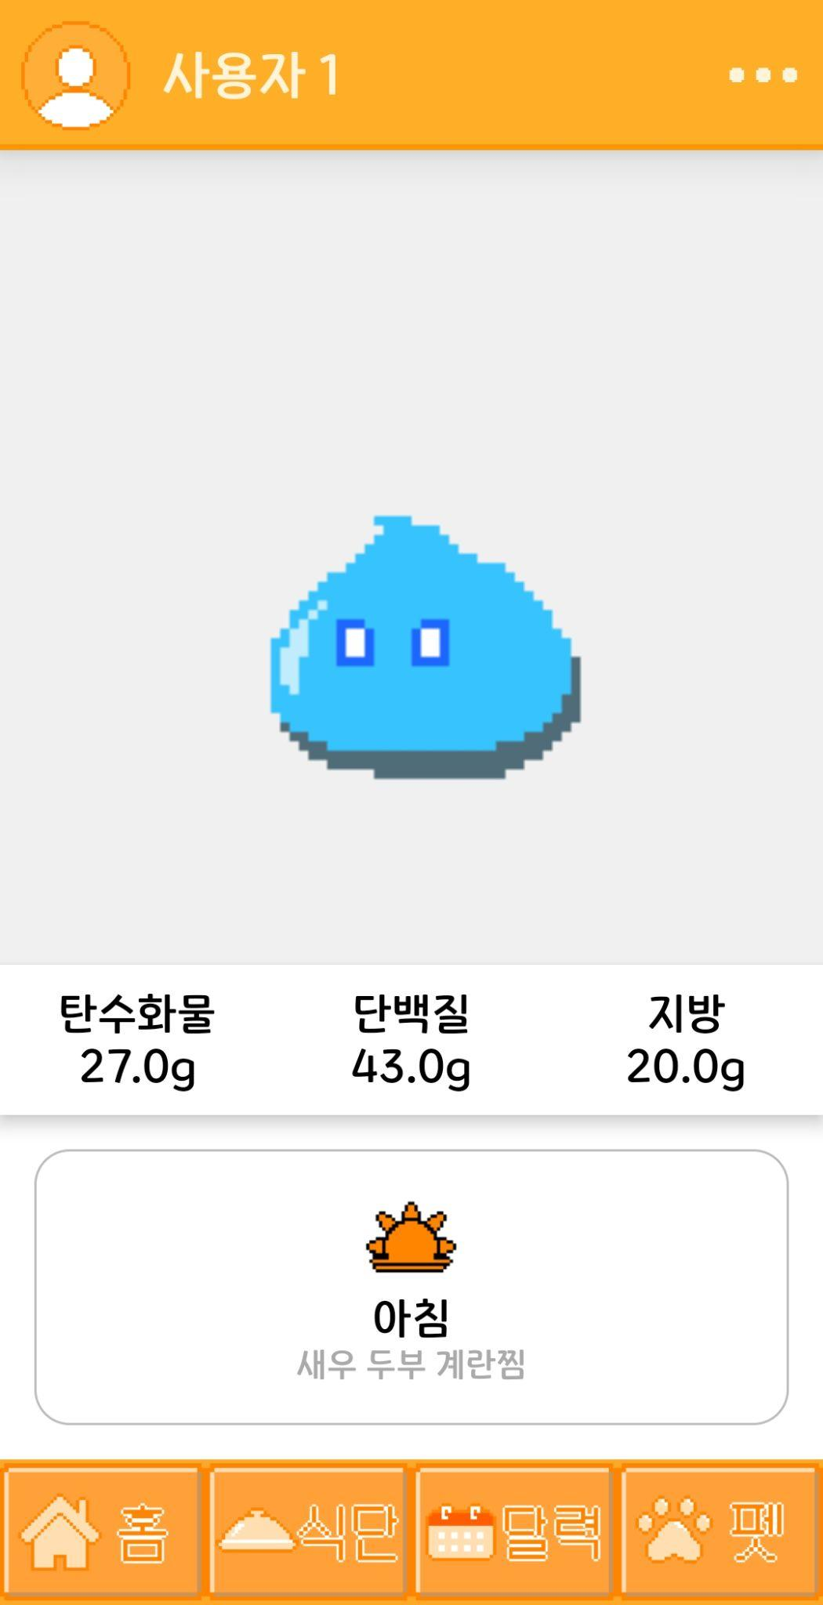
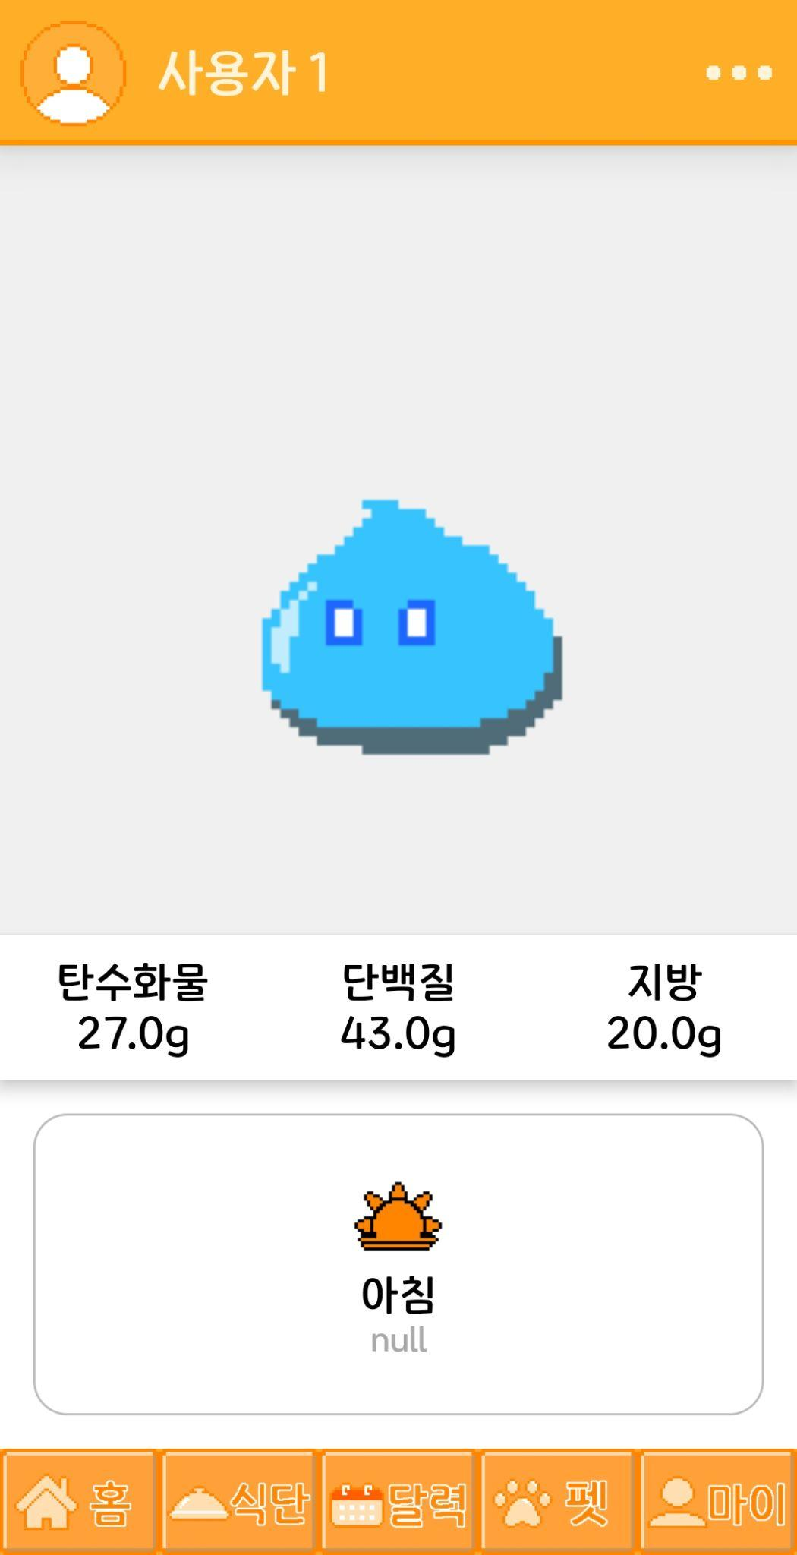
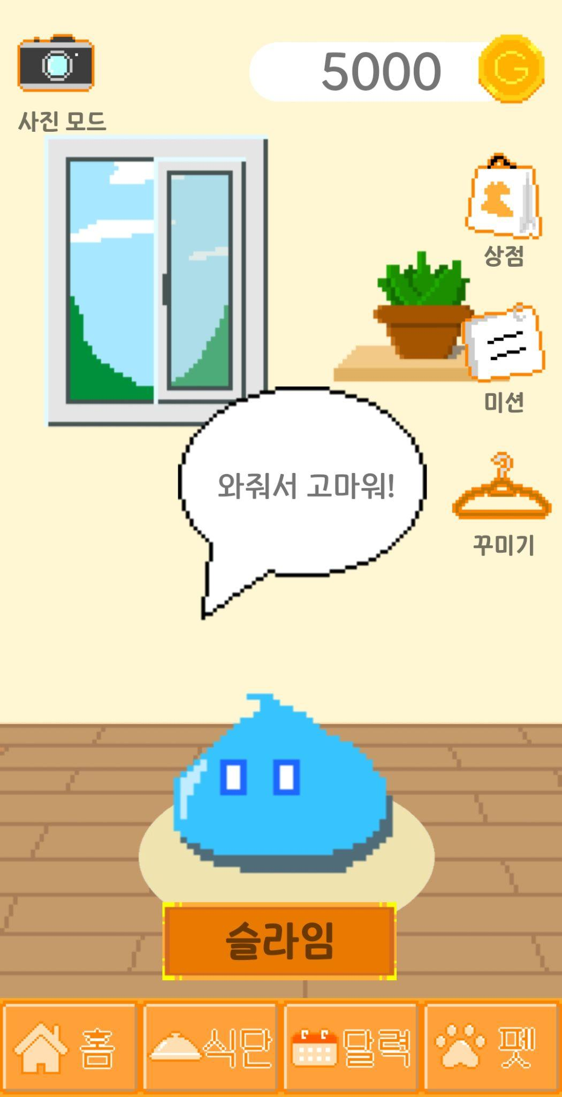
Mid-Final Production
Designing the UX - The app was designed for better one hand usage(for right hand users, mostly)

Slide 14



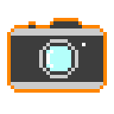
Mid-Final Production
Game-like UI - We designed the UI to look like somewhat of a game to not give a constricted, professional look - rather a casual look for better approach to the casual users

Slide 15
Difficulties during development and Fixes
While we developed the database, we first tried the JSON format for easier access - but it was actually harder in Java, which wasn’t expected
-> In the middle of our project, we had to change the database management system to SQLite which was done quick enough, but still was a miss in initial designing of the app development scheduling

Slide 16
Difficulties during development and Fixes
There is a memory leak issue when transitioning between pages, especially when navigating back to the previous page.
-> We attempted to fix it using the Navigation Component, but without proper implementation through a complex process, the memory leak issue remains unresolved. So in conclusion, we succeeded in fixing the memory leak by improving the already existing functionalities.

Slide 17
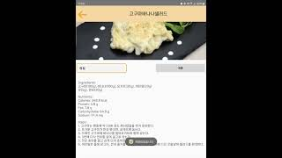
Preview Video

Slide 18
Future Plans, Q&A
Additional Features + UI/UX improvements
Missions related to our Pet Growth + More methods for getting in-app currencies
Bug fixes + Future Updates(and an actual release of the app)

